Slide 1
Sentiment Analysis Model Comparison: The Case of Tesla
Group A :
Belen Gutierrez, Binpeng Xiu, Marc Castillo, Siqi Zhao, Zehui Wang, Or’el Anbar
Notes:
Copy+Pasted from instructions:
‘Suggested’ Slides (and you can be creative here):
- Intro
- Walk through of overall architecture
- Quick overview of data used
- Quick overview of methodology and validation
- Performance Measures
- What did you like least and best about the project?
- Conclusion

Slide 2
Contents
Introduction and Inspiration
Walk through of Overall Architecture
Three Phases:
Overview of data used
Overview of methodology and validation
Performance Measures
What did you like least and best about the project?
Conclusion

Slide 3
Reference Article: TANG, WEI, YANG, CHEN
Article Title: Sentiment Analysis of Company-Related Tweets and their Prediction Power
Project Goal: “[T]o incorporate sentiment analysis result of tweets related to specific companies into the prediction for the company’s performance, i.e. their stock prices, and see how much weight user feedbacks on twitter have in the model.”

Slide 4
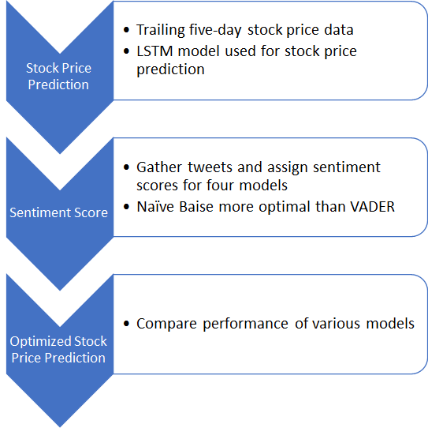

Methodology Overview: TANG, WEI, YANG, CHEN
Create a baseline by using a conventional stock price prediction model (LSTM)
Develop a sentiment score based on tweets about the company that is the subject of the analysis for four models
model with only daily score, model with only weekly score, model with tweet count and daily score, and model with tweet count and weekly score
Compare sentiment analysis with conventional stock price prediction to determine accuracy applicability

Slide 5
Outline of Our Methodology
Goal: Predict Tesla stock price using twitter sentiments
Phase 1: Data - sentiment140
Train our own classifier using Naive Baye and VADER for tweets
Phase 2: Data - tweets, & stock data
Phase 3: Stock price prediction using above two sets of senti scores: NB & VADER

Slide 6
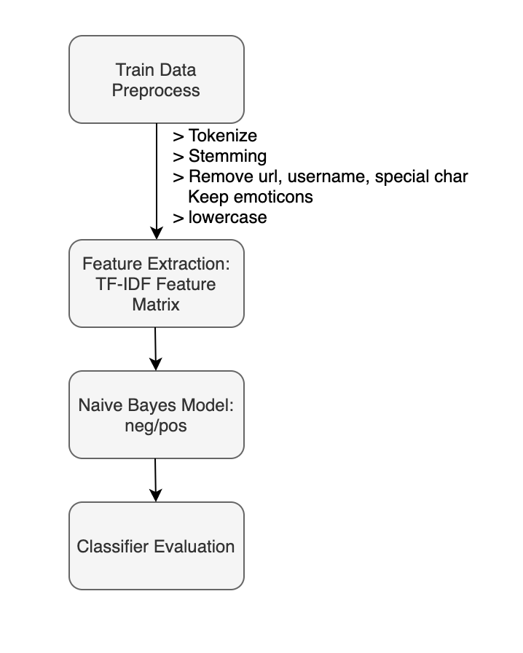
Phase 1: Train Naive Bayes Classifier
Training Set: Sentiment140
Provided by Stanford University students http://help.sentiment140.com/for-students
From April to June in 2009
128M raw twitter texts across multiple fields with sentiment label(0 for negative and 1 for positive)
Notes:
In Phase 1, we want to train a customized Naïve Bayes classifier which is specialized for twitter data and can recognize positive and negative sentiments of tweets. We chose Naïve Bayes model as per the reference paper, and also for its model simplicity and effectiveness. But we do keep in mind the strong assumption of conditional independence of features.
The dataset we used is sentiment140. It contains data in 2009 from April to June. The size of dataset is reasonable which is 128 megabytes. It contains topics of multiple fields with negative and positive sentiment labels.
The flow chart to the right shows the procedures of phase 1 which I will discuss in the next few slides
(next slide please)

Slide 7
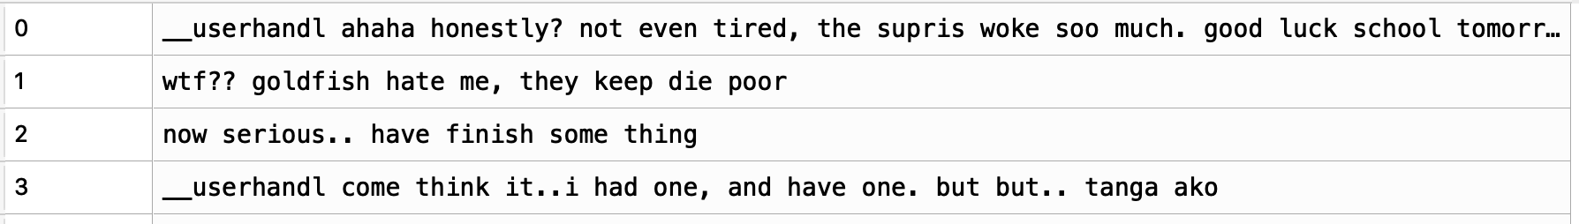
Phase 1:
Dataset Pre-processing:
Remove special characters, replace url, username with placeholder
Keep emoticons
Lowercase, Tokenize, Stemming
TF-IDF Vectorizer Matrix
Naive Bayes Modeling
Notes:
Before modeling, we first pre-processed our sentiment140 dataset by removing special characters, tokenizing and then stemming. In the process, we paid special attention to treat different special characters. We hard coded and kept emoticons in the twitter dataset to better classify sentiments. And we also replaced url and username with a meaningless placeholder to eliminate its effect in sentiment detection. Also we removed the hashtags sign but remained the keywords/topics which is useful for sentiment expression.
We then used tf-idf technique to vectorize our data and then fed them into the Naïve Bayes model.
(next slide please)

Slide 8
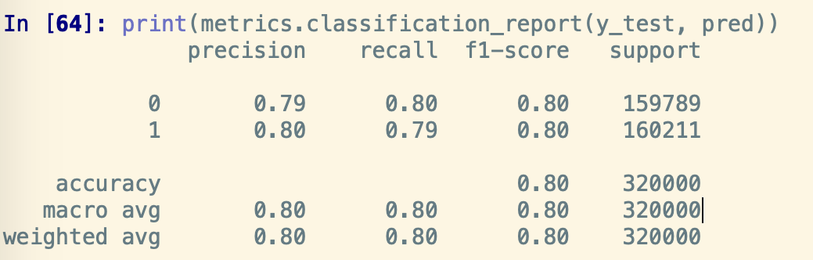
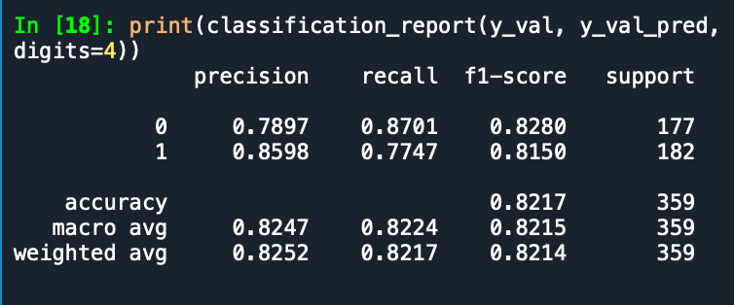
Phase 1: Model Evaluation
Validation Set: 20% Hold-out Set
Accuracy = 80%
Precision = TP/(TP+FP)
Recall = TP/(TP+FN)
Test Set: Manually Labeled
Accuracy = 82%
Precision = TP/(TP+FP)
Recall = TP/(TP+FN)
Notes:
Then we headed toward the Naive Bayes model evaluation.
We evaluated it first using the 20% hold-out set as validation set. On the right, we provided a snippet of our output of accuracy, precision and recall on our validation set. They are all around 80%, which is pretty nice. And we then go test it further. Marc will continue on it.

Slide 9
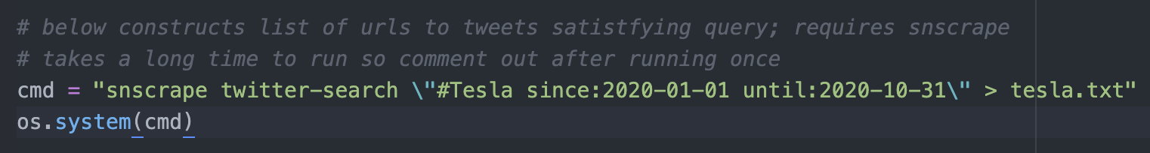
Custom Dataset for Sentiment Extraction
Connecting to official Twitter API via tweepy
Couldn’t directly search further back than a week with official search endpoint
Solution: snscrape to webscrape tweet URLS
Then could connect to different endpoint in official API to fetch tweets from URL
Collected tweets from January to October; sample size 345,605 after dropping missing values
Preprocessing
Dealt with special characters just as before
Used the TfIdfVectorizer to transform this into sparse matrix
Notes:
Marc
As mentioned, we want to use models trained on the already labeled sentiment140 dataset to generate sentiment scores for our own, custom-made dataset of tweets using #Tesla. I’ll first talk about how we pulled those tweets.
Due to relatively recent changes, official API’s search endpoint, which is what has traditionally been used for projects like these, had a limit on how far back you could search if you only had a free account. Third party wrappers were also rendered obsolete.
So we found a command-line based package that could scrape for tweet URLs based on a query
https://github.com/JustAnotherArchivist/snscrape
And there was a different official endpoint for getting the tweet info from the URL that wasn’t locked behind a premium.
Ended up with close to 350,000 tweets from January to October this year
Now we see on the next slide…

Slide 10
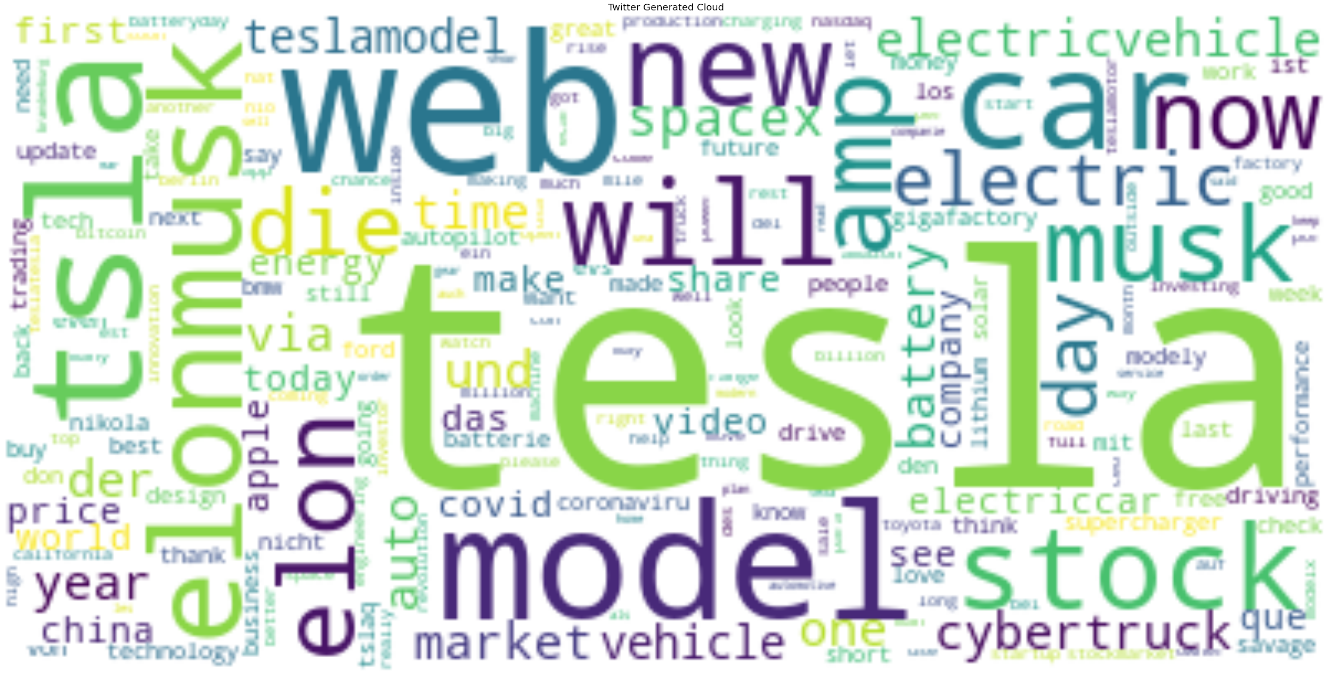
Plan for Custom Dataset
Extract Sentiment
Via own model and established ones out there
Merge with Financial data
Easy to download from Yahoo Finance - Tesla & NASDAQ
Then have to aggregate by Date to get a “composite” sentiment score per day
Ended up with a date-level dataset that spanned 194 trading days
Notes:
And to the right is a word-cloud to provide an idea of what’s actually in our corpus of tweets.
Our ultimate end is to use sentiment extracted from this dataset to boost the performance of a model that predicts Tesla stock price.
So we have to extract sentiment
We want to see how our own sentiment classifiers can compare to an established lexicon-based sentiment generator, VADER.
And we want to merge with financial data (which is itself easy enough to just download as a csv) and reshape our combined file so that the unit of observation was the day rather than tweets, which means that sentiment signals per day are a composite of sorts of all the tweets on a give day..
Ended up with 194 trading days from January to October

Slide 11
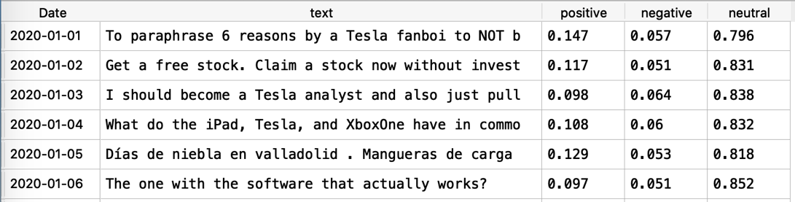
Phase 2: Sentiment Extraction
Method1: VADER
We use vader_lexicon in NLTK to execute the sentiment analysis, get the polarity for the Tweets of each day, which is how much positive, negative, neutral the Tweets are.
Notes:
We used two methods for sentiment extraction on twitter data. The first one is to use VADER lexicon in NLTK library to get the polar sentiment scores for each day.
VADER is a model attuned specially for social media. It recognizes emojis, acronyms, all capitals etc, which helps us better understand sentimental intensity.
https://github.com/cjhutto/vaderSentiment
We provided a snippet below of our output result. In the black square. Which indicates how much neutral, positive and negative each day people feel about Tesla.

Slide 12
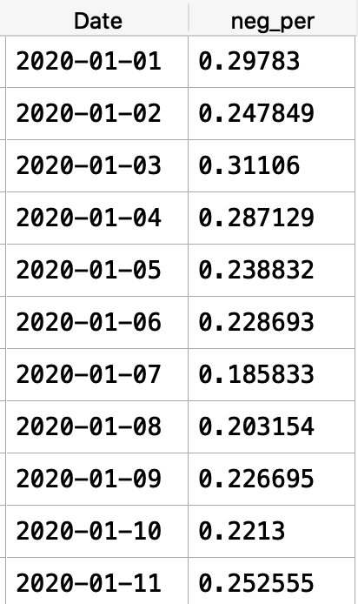
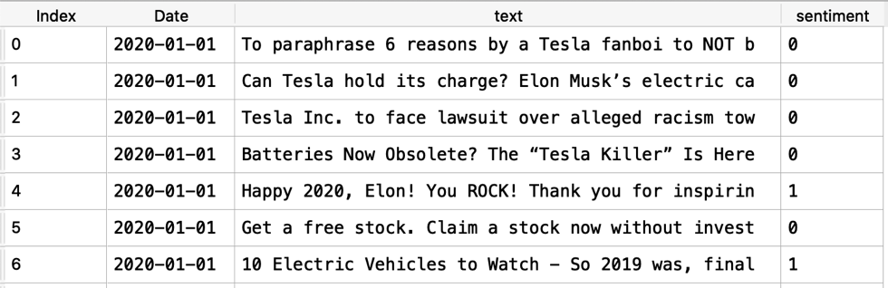
Phase 2: Sentiment Extraction
Method2: Naive Bayes
Notes:
The second method is to use our trained Naïve Bayes classifier in Phase 1. We calculated the percentage of tweets people felt negative about Tesla each day.
All the features listed in the dataframe will be considered for stock price modeling.
Then I will hand over to Kevin to talk about stock prediction in more details.

Slide 13
Phase 3: Stock Return Prediction
Models:
Linear Model: Ridge Regression
Nonlinear Model: Random Forest
Performance Measures
MSE - Mean Squared Error

Slide 14
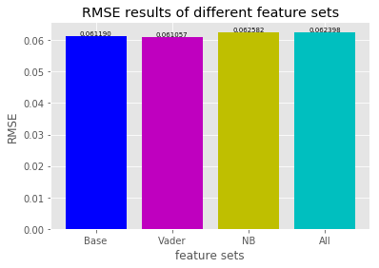
Linear Model - Ridge Regression
Four regressions:
Base: pre day Nasdaq/Volume
VADER: VADER score+base
NB: Naive Bayes scores+base
All: Vader+NB+base
Conclusion:
VADER+
NB -

Slide 15
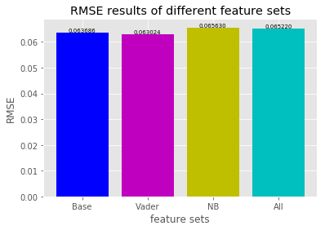
Nonlinear Model - Random Forest
Sentiment Extraction Method- VADER
Both our linear model (Ridge) & non-linear model (Random Forest) confirm that using VADER only as the sentiment extraction give the best MSE score
Ridge VADER (MSE: 0.003728) VS. Random Forest VADER (MSE: 0.004070)
Conclusion - Ridge Regression using VADER as the Sentiment Extraction methods does the prediction best

Slide 16
Best/Least Favourite Part
Learning Python modules and libraries by researching a topic we were interested in
Interacting with classmates to discuss methodology and learn from one another
Applying NLP to finance industry matters in line with latest industry trends
Delays in Twitter API approval
Communication wasn’t always easy
Small/ outdated training data size

Slide 17
Conclusions
Summary of findings
Minor performance boost using the VADER polarities but not with our own classifier
One limitation of our own classifier was training set labels only contained 2 classes
Next steps/Points of improvement
Can tinker with other preprocessing choices: changing tfidf properties, PCA
Try other classifiers on sentiment140 dataset
Notes:
In conclusion, we learned a lot about the process of starting with a corpus of words and going through a whole ML workflow.
To summarize our findings, we saw that in comparison to a baseline of leaving out sentiment information entirely, we saw a minor performance boost using the VADER polarities but not with our NaiveBayes classifier. That’s partly due to the aforementioned limitations of our training set itself.
In terms of next steps towards the final submission, we can still try other classifiers on our labeled dataset (like an SVM or LogisticRegression) or tinker with our preprocessing choices to try to find a performance boost; for example, our tfidf only considered unigrams and bigrams; although the efficacy of the resulting scores from making those adjustments as far as improving our stock price prediction results is yet to be seen.
And thanks for listening!

Slide 18
References
Reference Article: http://comp562fall18.web.unc.edu/files/2018/12/PP2.pdf
VADER Documentation: http://comp.social.gatech.edu/papers/icwsm14.vader.hutto.pdf
Pulling from twitter guide: https://medium.com/@jcldinco/downloading-historical-tweets-using-tweet-ids-via-snscrape-and-tweepy-5f4ecbf19032

